Slide 1





Area with low signal strength (-80 dBm)
Area with low signal strength (-30 dBm)
Area with low signal strength (-67 dBm)
Area with low signal strength (-70 dBm)

Slide 2
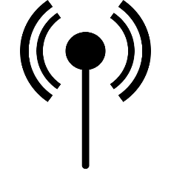
North
West
East
South
South-West
✔
X
X
Decreasing signal strength
Increasing signal strength
If user interact the signal direction
Intersecting signal direction

Slide 3
S1 – S2 > 0 Continue same direction
S1 – S2 < 0 Change the direction
S1 – S2 = 0 No movement
[ ]
F(S1, S2) =
Speed of Light (C)
Wavelength(λ)=
Frequency (F)
Wavelength(λ)
Height(H)=
4

